Slide 1
IPL Auction 2021
Oculus

Slide 2
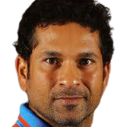


Sachin Tendulkar
BAT
96
10
10
9
-
-
-
2Cr

Slide 3
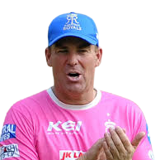

Shane Warne
BOW
95
-
-
-
8
10
9
2Cr

Slide 4
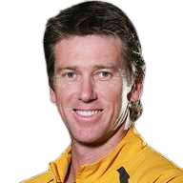
Glen McGrath
BOW
95
-
-
-
10
9
9
2Cr

Slide 5
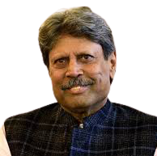
Kapil Dev
ALL
95
8
10
8
8
8
8
2Cr

Slide 6
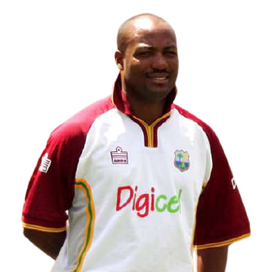
Brian Lara
BAT
95
9
10
9
-
-
-
2Cr

Slide 7
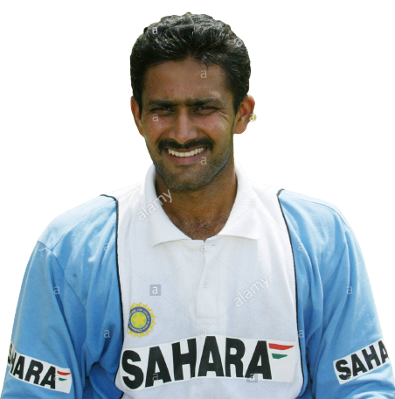
Anil Kumble
BOW
94
-
-
-
8
10
8
2Cr

Slide 8
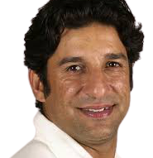
Wasim Akram
BOW
94
-
-
-
9
8
8
2Cr

Slide 9
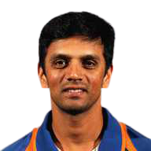
Rahul Dravid
BAT
94
10
9
8
-
-
-
2Cr

Slide 10
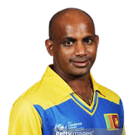
Sanath Jayasuriya
BAT
94
10
9
8
-
-
-
2Cr

Slide 11
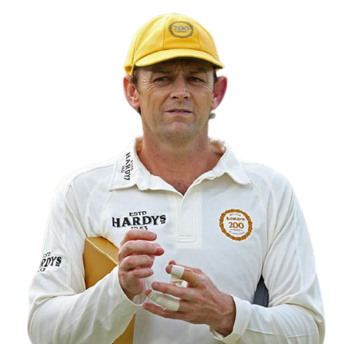
Adam Gilchrist (Wk)
BAT
94
10
8
8
-
-
-
2Cr

Slide 12
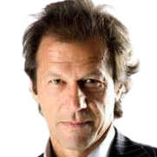
Imran Khan
ALL
93
7
8
8
9
9
8
2Cr

Slide 13
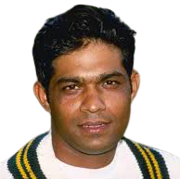
Mohammad Azharuddin
BAT
93
8
10
8
-
-
-
2Cr

Slide 14
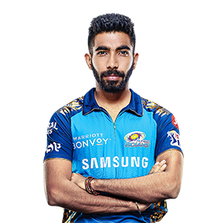

Jasprit Bumrah
BOW
92
-
-
-
9
9
10
2Cr

Slide 15
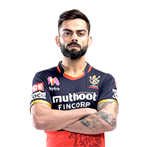

Virat Kohli
BAT
92
9
10
8
-
-
-
2Cr

Slide 16
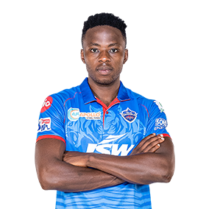

Kagiso Rabada
BOW
91
-
-
-
8
9
10
2Cr

Slide 17
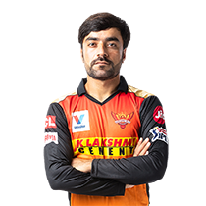

Rashid Khan
BOW
91
-
-
-
8
10
9
2Cr

Slide 18
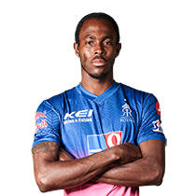

Jofra Archer
BOW
91
-
-
-
10
8
9
2Cr

Slide 19
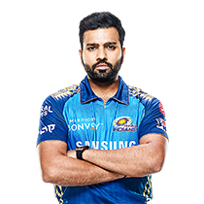
Rohit Sharma
BAT
91
10
8
9
-
-
-
2Cr

Slide 20

David Warner
BAT
91
10
9
8
-
-
-
2Cr

Slide 21
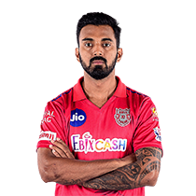

KL Rahul (Wk)
BAT
91
10
8
8
-
-
-
2Cr

Slide 22
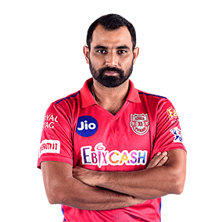
Mohammad Shami
BOW
90
-
-
-
9
8
10
2Cr

Slide 23
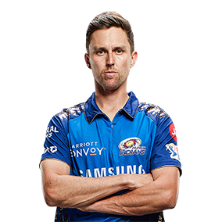
Trent Boult
BOW
90
-
-
-
10
8
9
2Cr

Slide 24
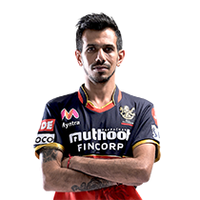
Yuzvendra Chahal
BOW
90
-
-
-
8
10
8
2Cr

Slide 25
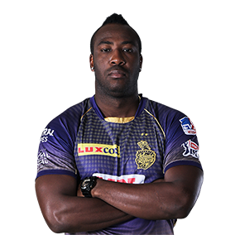

Andre Russell
ALL
90
6
8
10
7
7
8
2Cr

Slide 26

AB de Villiers (Wk)
BAT
90
8
9
10
-
-
-
2Cr

Slide 27
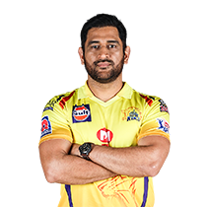

MS Dhoni (Wk)
BAT
90
7
9
10
-
-
-
2Cr

Slide 28

Jos Buttler (Wk)
BAT
90
8
10
9
-
-
-
2Cr

Slide 29

Anrich Nortje
BOW
89
-
-
-
9
8
9
2Cr

Slide 30
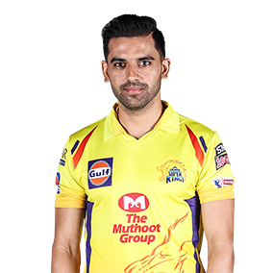
Deepak Chahar
BOW
89
-
-
-
10
7
8
2Cr

Slide 31


Hardik Pandya
ALL
89
6
7
10
7
7
8
2Cr

Slide 32

Ben Stokes
ALL
89
9
8
8
7
7
7
2Cr

Slide 33
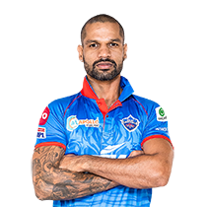
Shikhar Dhawan
BAT
89
9
8
8
-
-
-
2Cr

Slide 34
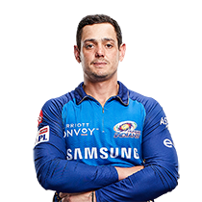
Quinton de Kock (Wk)
BAT
89
10
8
7
-
-
-
2Cr

Slide 35
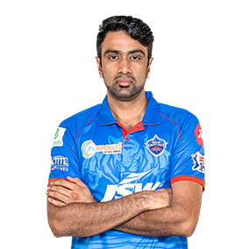
Ravichandran Ashwin
BOW
88
-
-
-
8
10
8
2Cr

Slide 36
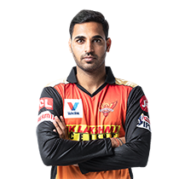
Bhuvneshwar Kumar
BOW
88
-
-
-
10
8
8
2Cr

Slide 37
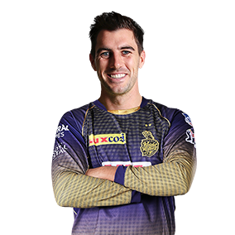
Pat Cummins
BOW
88
-
-
-
9
8
8
2Cr

Slide 38
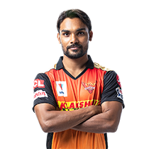
Sandeep Sharma
BOW
88
-
-
-
9
7
8
1.5Cr

Slide 39
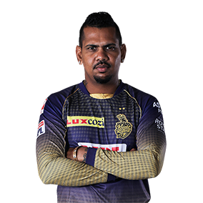
Sunil Narine
ALL
88
7
6
5
7
9
5
2Cr

Slide 40

Eoin Morgan
BAT
88
6
9
9
-
-
-
2Cr

Slide 41
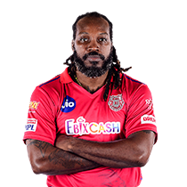
Chris Gayle
BAT
88
9
8
8
-
-
-
2Cr

Slide 42
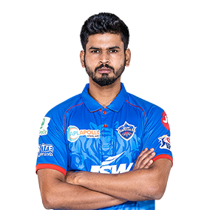
Shreyas Iyer
BAT
88
8
10
7
-
-
-
2Cr

Slide 43
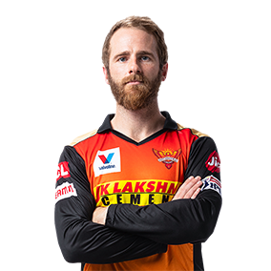
Kane Williamson
BAT
88
8
10
7
-
-
-
2Cr

Slide 44
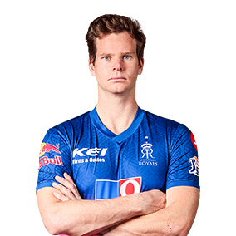
Steve Smith
BAT
88
8
9
7
-
-
-
2Cr

Slide 45
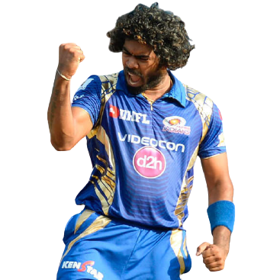
Lasith Malinga
BOW
87
-
-
-
8
7
10
2Cr

Slide 46
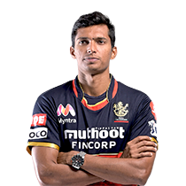
Navdeep Saini
BOW
87
-
-
-
8
7
9
2Cr

Slide 47
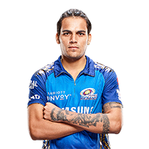
Rahul Chahar
BOW
87
-
-
-
7
9
8
1.5Cr

Slide 48
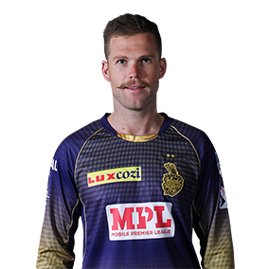
L Ferguson
BOW
87
-
-
-
8
8
8
1.5Cr

Slide 49
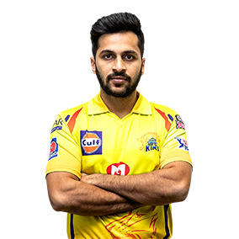
Shardul Thakur
BOW
87
-
-
-
7
8
8
1.5Cr

Slide 50
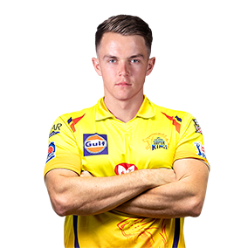
Sam Curran
ALL
87
7
6
7
8
7
8
2Cr

Slide 51
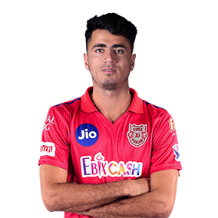
Mujeeb Ur Rahman
BOW
87
-
-
-
8
9
7
1.5Cr

Slide 52
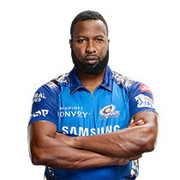
Kieron Pollard
ALL
87
6
8
9
6
7
7
2Cr

Slide 53
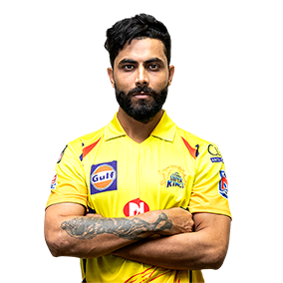
Ravindra Jadeja
ALL
87
6
7
8
6
8
6
2Cr

Slide 54
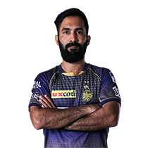
Dinesh Karthik (Wk)
BAT
87
6
8
9
-
-
-
2Cr

Slide 55
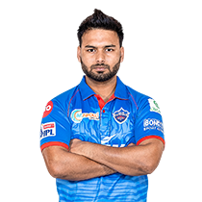
Rishabh Pant (Wk)
BAT
87
6
9
8
-
-
-
2Cr

Slide 56
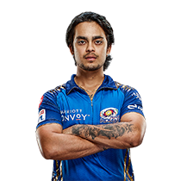
Ishan Kishan (Wk) (UC)
BAT
87
8
7
8
-
-
-
2Cr

Slide 57
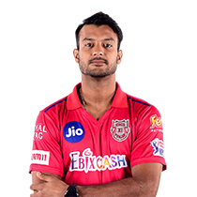
Mayank Agarwal
BAT
87
9
8
7
-
-
-
2Cr

Slide 58
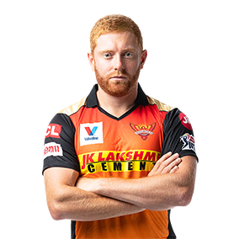
Johny Bairstow (Wk)
BAT
87
9
8
7
-
-
-
2Cr

Slide 59

Sanju Samson (Wk)
BAT
87
8
8
7
-
-
-
2Cr

Slide 60

Suryakumar Yadav (UC)
BAT
87
8
8
7
-
-
-
2Cr

Slide 61

Nathan Coulter Nile
BOW
86
-
-
-
7
8
8
1.5Cr

Slide 62

Lungi Ngidi
BOW
86
-
-
-
8
7
8
1.5Cr

Slide 63

James Pattinson
BOW
86
-
-
-
8
7
8
1.5Cr

Slide 64

Adam Zampa
BOW
86
-
-
-
7
9
7
1.5Cr

Slide 65

Chris Morris
ALL
86
5
7
7
8
8
7
1.5Cr

Slide 66

Isuru Udana
BOW
86
-
-
-
7
8
7
1Cr

Slide 67

Jaydev Unadkat
BOW
86
-
-
-
7
8
7
1.5Cr

Slide 68

Mohammed Siraj
BOW
86
-
-
-
8
7
7
1.5Cr

Slide 69

Marcus Stoinis
ALL
86
8
7
8
7
7
7
1.5Cr

Slide 70

Amit Mishra
BOW
86
-
-
-
6
9
6
1.5Cr

Slide 71

Kuldeep Yadav
BOW
86
-
-
-
6
9
6
2Cr

Slide 72

Glenn Maxwell
ALL
86
6
8
9
7
8
5
2Cr

Slide 73

Nicholas Pooran (Wk)
BAT
86
6
8
9
-
-
-
2Cr

Slide 74

Suresh Raina
BAT
86
8
9
8
-
-
-
2Cr

Slide 75

Faf Du Plessis
BAT
86
9
8
8
-
-
-
2Cr

Slide 76

Manish Pandey
BAT
86
8
8
8
-
-
-
2Cr

Slide 77

Shane Watson
BAT
86
8
8
7
-
-
-
1.5Cr

Slide 78

Nitish Rana (UC)
BAT
86
7
8
7
-
-
-
1.5Cr

Slide 79

Aaron Finch
BAT
86
9
7
6
-
-
-
1.5Cr

Slide 80

Devdutt Padikkal (UC)
BAT
86
9
7
6
-
-
-
1.5Cr

Slide 81

Shubman Gill
BAT
86
8
7
6
-
-
-
1.5Cr

Slide 82

Ajinkya Rahane
BAT
86
8
8
5
-
-
-
1.5Cr

Slide 83

Dwayne Bravo
ALL
85
6
7
7
6
7
8
1.5Cr

Slide 84

Mohit Sharma
BOW
85
-
-
-
7
8
7
1Cr

Slide 85

Ishant Sharma
BOW
85
-
-
-
8
7
7
1Cr

Slide 86

Josh Hazlewood
BOW
85
-
-
-
8
7
7
1Cr

Slide 87

Umesh Yadav
BOW
85
-
-
-
8
7
7
1.5Cr

Slide 88

Khaleel Ahmed
BOW
85
-
-
-
8
7
7
1Cr

Slide 89

Imran Tahir
BOW
85
-
-
-
6
9
6
1Cr

Slide 90

Sheldon Cottrell
BOW
85
-
-
-
8
8
6
1Cr

Slide 91

Piyush Chawla
BOW
85
-
-
-
6
8
6
1Cr

Slide 92

Ravi Bishnoi (UC)
BOW
85
-
-
-
6
8
6
0.5Cr

Slide 93

Rahul Tewatia (UC)
ALL
85
5
6
7
5
7
6
0.5Cr

Slide 94

Washington Sundar
ALL
85
5
6
7
8
8
5
1Cr

Slide 95

Krunal Pandya
ALL
85
5
7
7
7
8
5
1.5Cr

Slide 96

Shimron Hetmyer
BAT
85
6
7
8
-
-
-
1Cr

Slide 97

Ambati Rayudu
BAT
85
8
8
7
-
-
-
1Cr

Slide 98

Wriddhiman Saha (Wk)
BAT
85
8
6
6
-
-
-
1Cr

Slide 99

Chris Jordan
ALL
84
5
6
5
6
7
8
1Cr

Slide 100

Andrew Tye
BOW
84
-
-
-
7
6
7
1Cr

Slide 101

S Kaul
BOW
84
-
-
-
7
6
7
1Cr

Slide 102

Mitchell Santner
BOW
84
-
-
-
6
8
6
0.5Cr

Slide 103

Shahbaz Nadeem
BOW
84
-
-
-
6
8
6
0.5Cr

Slide 104

Jayant Yadav
BOW
84
-
-
-
5
8
6
0.5Cr

Slide 105

Kartik Tyagi (UC)
BOW
84
-
-
-
6
7
6
0.5Cr

Slide 106

Dale Steyn
BOW
84
-
-
-
8
6
6
1Cr

Slide 107

Axar Patel
ALL
84
5
6
6
6
8
5
1Cr

Slide 108

Varun C. (UC)
BOW
84
-
-
-
6
8
5
1Cr

Slide 109

Shreyas Gopal (UC)
BOW
84
-
-
-
6
8
5
0.5Cr

Slide 110

Alex Carey (Wk)
BAT
84
6
6
8
-
-
-
0.5Cr

Slide 111

Chris Lynn
BAT
84
8
6
6
-
-
-
1Cr

Slide 112

Ruturaj Gaikwad (UC)
BAT
84
7
7
5
-
-
-
0.5Cr

Slide 113

Prithvi Shaw
BAT
84
8
6
5
-
-
-
1Cr

Slide 114

Jimmy Neesham
ALL
83
5
5
7
7
6
7
0.5Cr

Slide 115

Shivam Mavi (UC)
BOW
83
-
-
-
6
6
7
0.5Cr

Slide 116

Mohammad Nabi
ALL
83
5
6
6
6
8
6
1Cr

Slide 117

Karna Sharma
BOW
83
-
-
-
5
8
6
0.5Cr

Slide 118

Shivam Dube
ALL
83
5
6
7
6
7
6
0.5Cr

Slide 119

Moeen Ali
ALL
83
6
7
7
5
7
6
0.5Cr

Slide 120

Murugan Ashwin (UC)
BOW
83
-
-
-
5
7
6
0.5Cr

Slide 121

Daniel Sams
ALL
83
5
6
7
7
6
6
0.5Cr

Slide 122

Tom Curran
ALL
83
5
6
6
7
6
6
0.5Cr

Slide 123

Krishnappa Gowtham (UC)
ALL
83
5
5
6
6
6
6
0.2Cr

Slide 124

Vijay Shankar
ALL
83
6
7
7
5
6
5
1Cr

Slide 125

David Miller
BAT
83
5
7
8
-
-
-
0.5Cr

Slide 126

Abdul Samad (UC)
BAT
83
5
6
7
-
-
-
0.5Cr

Slide 127

Deepak Hooda (UC)
BAT
83
5
6
7
-
-
-
0.5Cr

Slide 128

Robin Uthappa (Wk)
BAT
83
7
7
6
-
-
-
0.5Cr

Slide 129

Kedar Jadhav
BAT
83
6
7
6
-
-
-
0.5Cr

Slide 130

Tom Banton (Wk)
BAT
83
7
6
6
-
-
-
0.2Cr

Slide 131

Karun Nair
BAT
83
6
6
6
-
-
-
0.5Cr

Slide 132

Priyam Garg (UC)
BAT
83
5
6
6
-
-
-
0.2Cr

Slide 133

Rahul Tripathi (UC)
BAT
83
7
5
6
-
-
-
0.5Cr

Slide 134

Yashasvi Jaiswal (UC)
BAT
83
7
5
5
-
-
-
0.2Cr

Slide 135

Keemo Paul
ALL
82
5
6
6
7
6
6
0.2Cr

Slide 136

Varun Aron
BOW
82
-
-
-
6
6
6
0.2Cr

Slide 137

Dhawal Kulakarni
BOW
82
-
-
-
7
5
6
0.5Cr

Slide 138

Prasidh Krishna (UC)
BOW
82
-
-
-
6
5
6
0.2Cr

Slide 139

Pawan Negi
ALL
82
5
6
5
5
7
5
0.2Cr

Slide 140

Kamlesh Nagarkoti (UC)
BOW
82
-
-
-
5
7
5
0.2Cr

Slide 141

Mitchell Marsh
ALL
82
6
7
6
6
6
5
0.5Cr

Slide 142

Mandeep Singh
BAT
82
7
6
6
-
-
-
0.5Cr

Slide 143

Gurkeerat Man Singh
BAT
82
5
6
6
-
-
-
0.2Cr

Slide 144

Josh philippe (Wk)
BAT
82
7
5
6
-
-
-
0.2Cr

Slide 145

Harshal Patel (UC)
ALL
81
5
5
6
5
5
6
0.2Cr

Slide 146

Riyan Parag (UC)
BAT
81
5
5
6
-
-
-
0.2Cr

Slide 147

Sarfaraz Khan (UC)
BAT
81
5
5
6
-
-
-
0.5Cr

Slide 148

Murali Vijay
BAT
81
7
5
5
-
-
-
0.5Cr

Slide 149

Abhishek Sharma (UC)
ALL
80
5
5
6
5
6
5
0.2Cr

Slide 150

Ankit Rajpoot (UC)
BOW
80
-
-
-
6
5
5
0.2Cr

